Slide 1


Here's your outline to get started
Key facts about your topic
A hospital is a health care institution providing patient treatment with specialized medical and nursing staff and medical equipment. The best-known type of hospital is the general hospital, which typically has an emergency department to treat urgent health problems ranging from fire and accident victims to a sudden illness. A district hospital typically is the major health care facility in its region, with many beds for intensive care and additional beds for patients who need long-term care. Specialized hospitals include trauma centers, rehabilitation hospitals, children's hospitals, seniors' hospitals, and hospitals for dealing with specific medical needs such as psychiatric treatment and certain disease categories. Specialized hospitals can help reduce health care costs compared to general hospitals. Hospitals are classified as general, specialty, or government depending on the sources of income received.
See more: Open the Notes below for more information.
Notes:
QuickStarter has created an outline to help you get started on your presentation. Some slides include information here in the notes to provide additional topics for you to research.

Slide 2
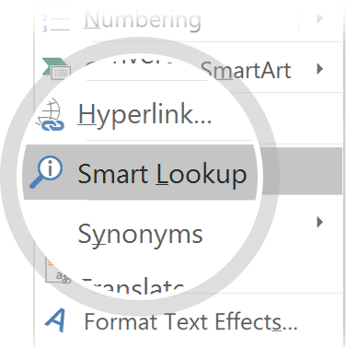
Related topics to research
History of hospitals
Health Care
Physician
Public hospital
Health facility
School
Health
Outpatient clinic
Health care in the United States
Radiology
Use Smart Lookup to learn more
1
Highlight one of the related topics
Right-click on the topic
Choose "Smart Lookup"
2
3

Slide 3
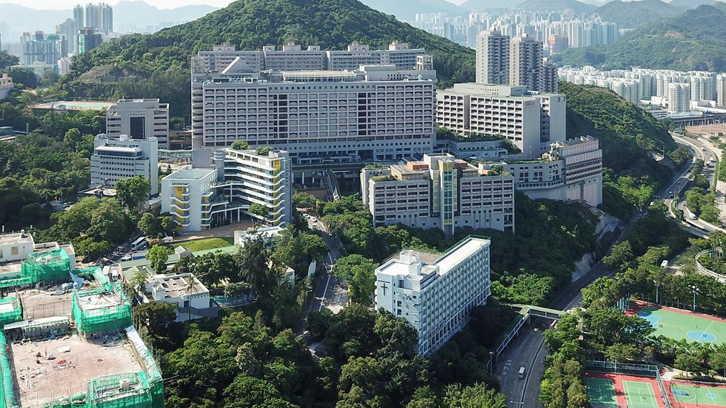
WDC Hospital
We care for you !

Slide 4
Contents
Etymology
Types
Departments or wards
History
Funding
Quality and safety
Buildings

Slide 5

Etymology

Slide 6
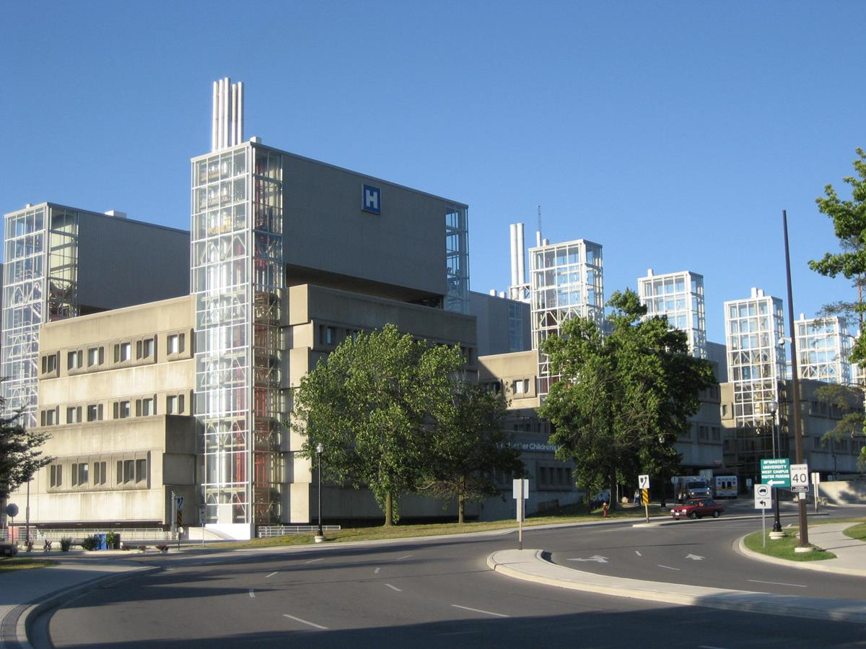
Multi-speciality Offerings
We are best in New York !
Notes:
Consider talking about:
General and acute care
District
Specialised
Teaching
Clinics

Slide 7
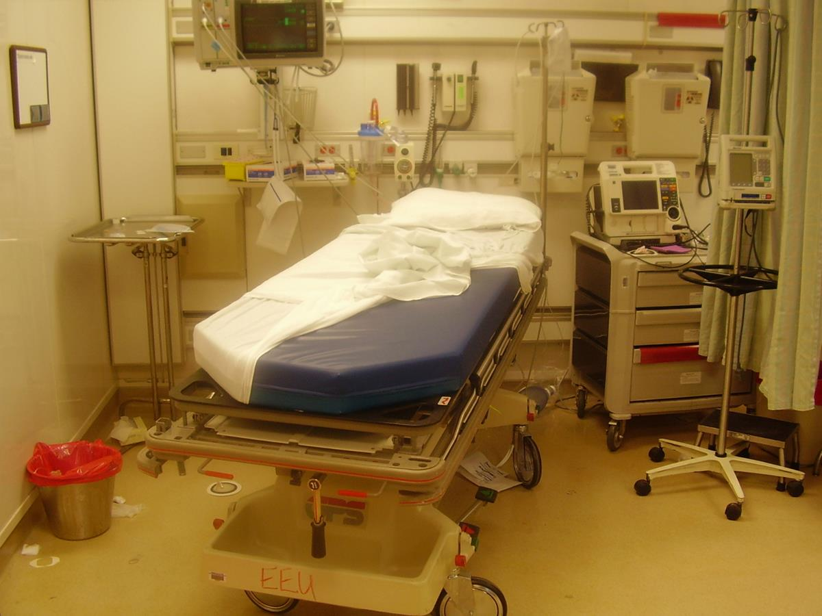
Specialized Care

Slide 8
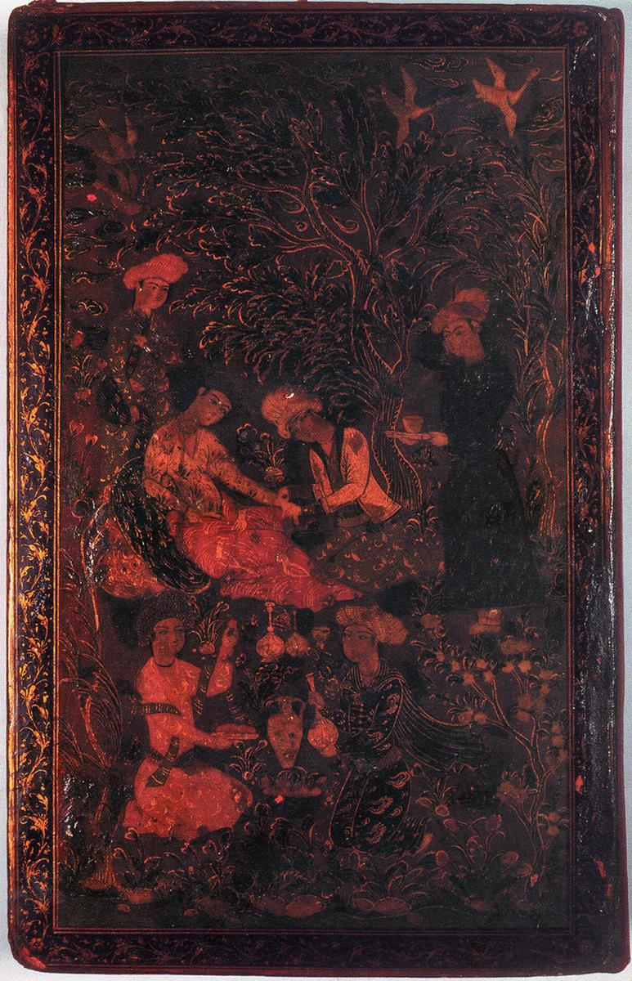
History
Look in the slide notes below for topics to consider talking about
Notes:
Consider talking about:
Early examples
Medieval Islamic world
Early modern and Enlightenment Europe
19th century
20th century and beyond

Slide 9
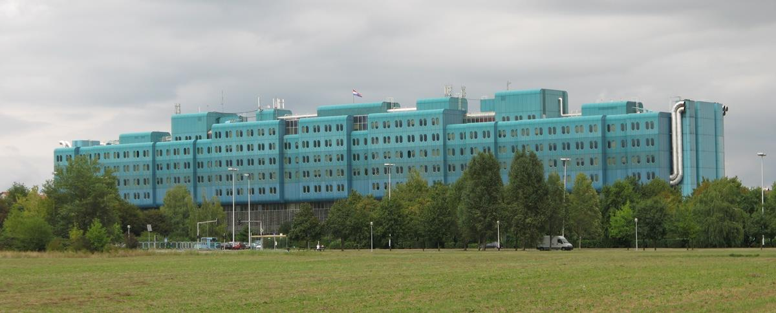
Funding

Slide 10
Quality and safety

Slide 11
Buildings
Look in the slide notes below for topics to consider talking about
Notes:
Consider talking about:
Architecture

Slide 12
Works cited

